Slide 1

Gate Monitoring System V1.0
This presentation outlines the design and implementation of a Gate Monitoring System (GMS) . The GMS will utilize various sensors, an audio module, and an LCD display to provide real-time monitoring and announcements for gate activity.

Slide 2
System Overview
Hardware
RaayanMini microcontroller
Reed sensor
Software
IR sensor
Keil IDE
JQ6500 Flash Loader
Keil IDE
JQ6500 Flash Loader
Dock Light and tera term for testing
Audio Module JQ6500
Speaker

Slide 3
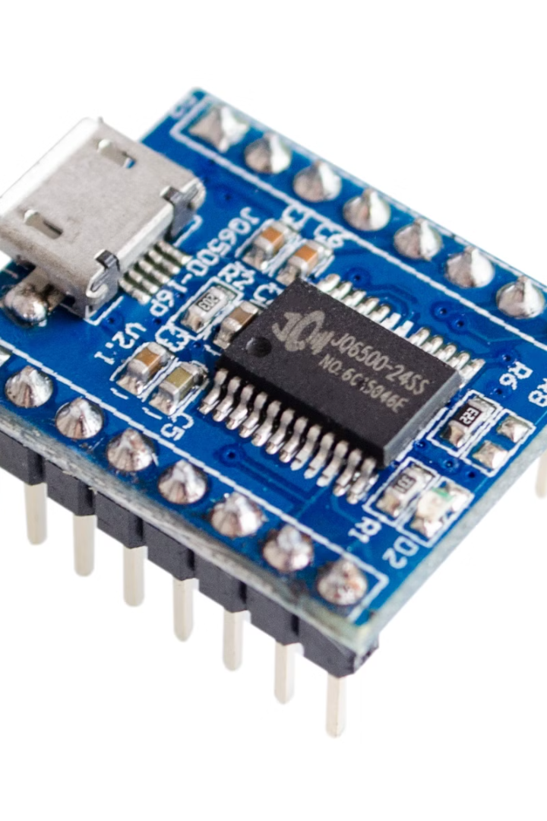
JQ6500 MP3 Player Control
Introduction
The JQ6500 MP3 module is a hardware decoder that integrates MP3 and WMV playback.
It supports TF card driver, SPI flash update, and FAT16/FAT32 file systems.
Features
Supports various sampling rates, 24-bit DAC output, and 30 levels of volume adjustment.
It can play specific music through serial commands and supports inter-cut announcements.

Slide 4
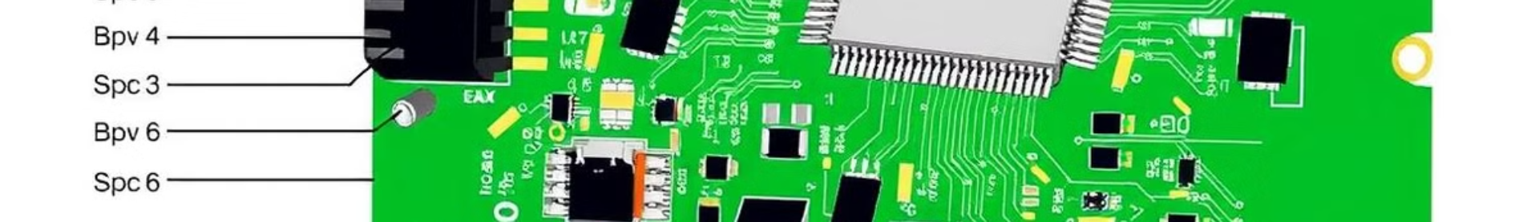
Electrical Characteristics
MP3 File Format
Supports all bit rates 11172-3 and ISO13813-3 layer3 audio decoding.
Sampling Rate
Supports 8/11.025/12/16/22.05/24/32/44.1/48 KHz.
UART Interface
Standard serial port, TTL level, baud rate configurable.
Input Voltage
Power supply 3.5V-5V; optimum value 4.2V.
Rated Current
20mA.
Size
Standard DIP16 package.
Speaker Power
8 ohm / 3W.
Operating Temperature
-40°C~80°C.
Humidity
5% ~ 95%.

Slide 5









Pin Description
K1-K5
SGND
ADKEY
BUSY
Audio output pins.
Ground pin.
AD port pin.
Play indicator pin.
TX UART
RX UART
GND
VCC 5V
Serial data output pin.
Serial data input pin.
Ground pin.
Power supply pin.
ADC_R/L
SPK+/-
Amplifier or headphone output pins.
Speaker connection pins.

Slide 6
Communication Basics
UART Protocol
Voltage Level
The JQ6500 uses a UART (Universal Asynchronous Receiver/Transmitter) protocol for communication.
Communication occurs at 3.3v, with a 1k resistor for 5v devices.
Command Structure
1
Start Byte
2
Byte Count
3
Command Byte
Always begins with 0x7E.
Indicates the number of bytes following, including the termination byte.
Specifies the action to be performed.
4
Arguments
5
Termination Byte
Optional parameters for the command.
Ends with 0xEF.

Slide 7
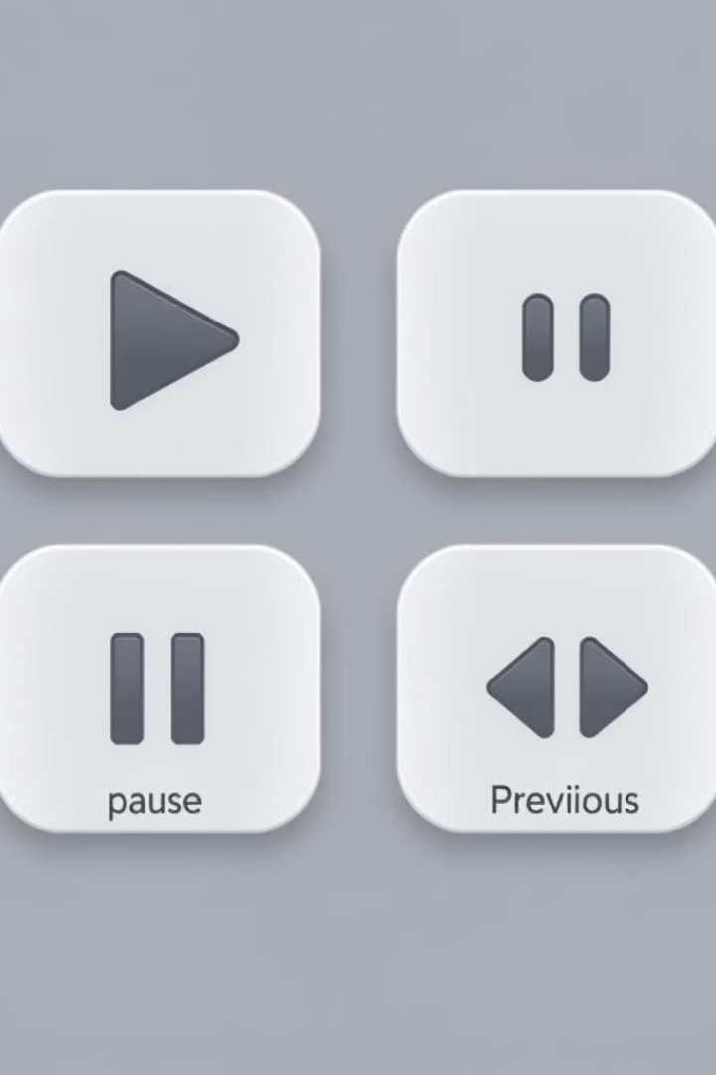
Control Commands
Play
Pause
0x0D, no arguments.
0x0E, no arguments.
Next
Previous
0x01, no arguments.
0x02, no arguments.

Slide 8

Control Commands (cont.)
Play File by Index
Change Folder
0x03, 2 arguments: high and low 8 bits of index number.
0x0F, 1 argument: 0x01 for next, 0x00 for previous.
Play File by Folder and Name
0x12, 2 arguments: folder number and file number.

Slide 9
Control Commands (cont.)
Play File by Index
Change Folder
0x03, 2 arguments: high and low 8 bits of index number.
0x0F, 1 argument: 0x01 for next, 0x00 for previous.
Play File by Folder and Name
0x12, 2 arguments: folder number and file number.

Slide 10
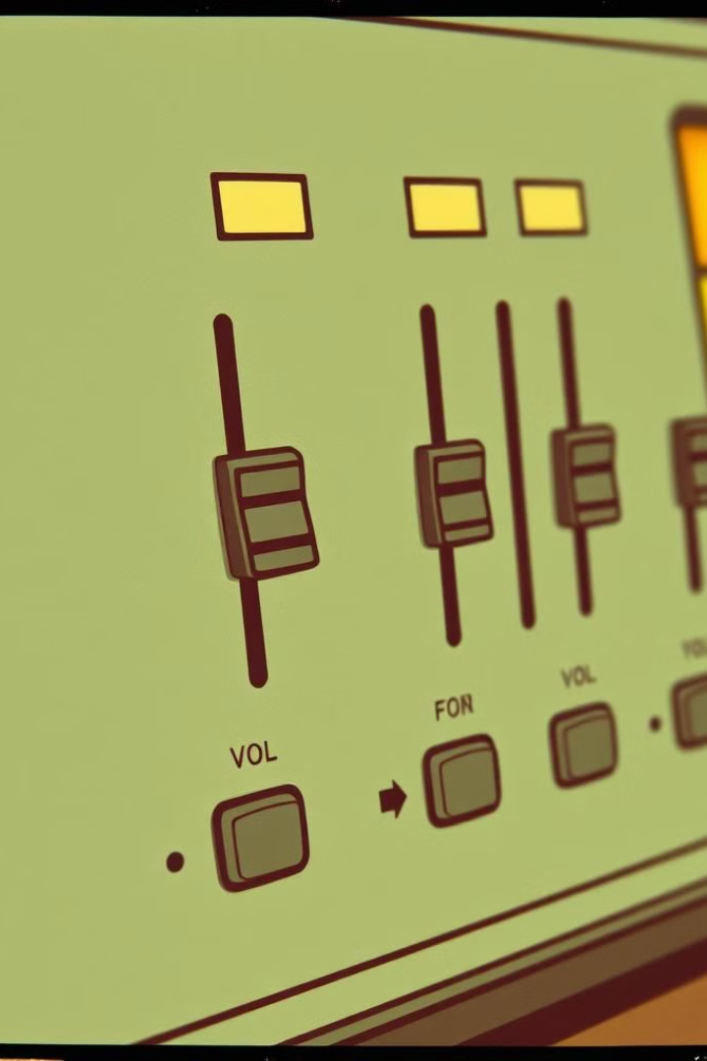
Control Commands (cont.)
Volume Up
0x04, no arguments.
Volume Down
0x05, no arguments.
Set Volume
0x06, 1 argument: byte value from 0 to 30.
Set Equalizer Mode
0x07, 1 argument: byte value for different modes.

Slide 11

Query Commands (cont.)
Get Version
Count Files on SD Card
0x46, no arguments. Response: integer.
0x47, no arguments. Response: integer.
Count Files in Flash Memory
0x49, no arguments. Response: integer.

Slide 12
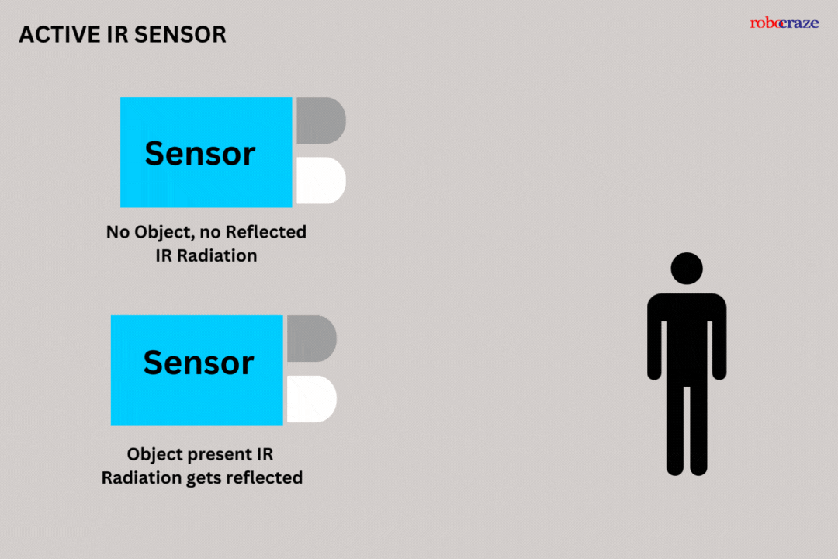
IR Sensor Module
Introduction
The IR sensor module has a pair of infrared transmitting and receiving tubes.
When the transmitted light waves are reflected back, the receiver tube detects them.
Applications
Night vision devices, radiation thermometers, flame monitors, water analysis, and rail safety.

Slide 13

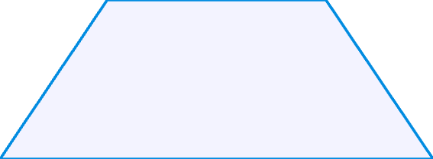

Principle of IR Sensor Operation
Detection
1
Passive IR sensors detect changes in infrared radiation emitted by objects, while active IR sensors emit IR beams and measure the time it takes for the beams to reflect back.
Signal Processing
2
The sensor converts the detected infrared radiation into an electrical signal, which is then processed to determine the presence or absence of an object.
Output
3
The processed signal is used to trigger an action, such as activating a light or sending a signal to a control system.

Slide 14
Reed Sensor
Introduction
Features
A reed sensor is an electrically controlled switch used for switching a power circuit.
Easy to install, strong concealment, magnetic sensor alarm, and ideal for residential or commercial use.
It provides an accurate indication of the door's position (open/closed).

Slide 15
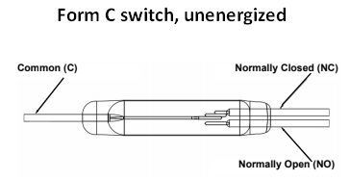
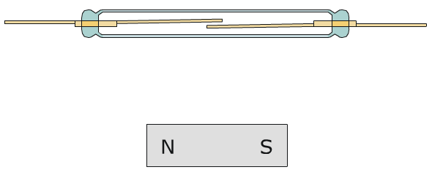
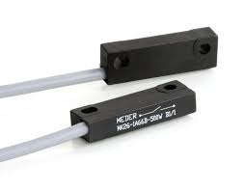
Overview of Reed Sensors
Simple Design
1
Reed sensors consist of two magnetically sensitive contacts within a sealed glass capsule. These contacts are typically made of a ferromagnetic material.
Magnetic Activation
2
When a magnetic field is applied to the sensor, the contacts close, completing an electrical circuit. When the magnetic field is removed, the contacts open.
Versatile Applications
3
Reed sensors find use in various applications, including door and window sensors, fluid level sensing, and position sensing in industrial equipment.

Slide 16
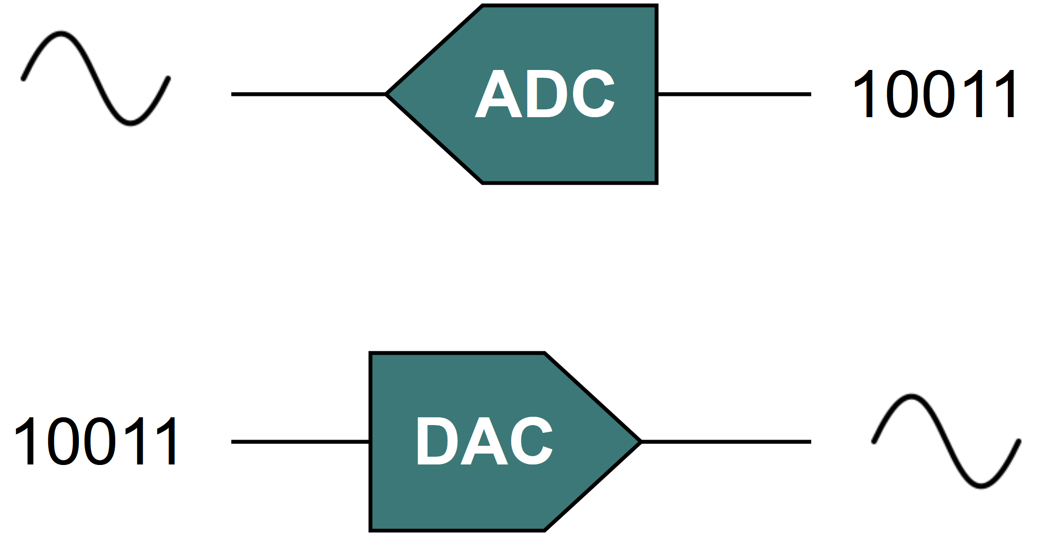
Key Factors
ADC
DAC
An analog-to-digital converter (ADC) converts an analog signal into a digital signal.
A digital-to-analog converter (DAC) converts a digital signal into an analog signal.
Sampling
EQ
A continuous time signal can be represented in its samples and recovered back when the sampling frequency is greater than or equal to twice the highest frequency component of the message signal.
Equalization (EQ) in music adjusts the level or amplitude of specific frequencies to achieve a clear and balanced mix.

Slide 17
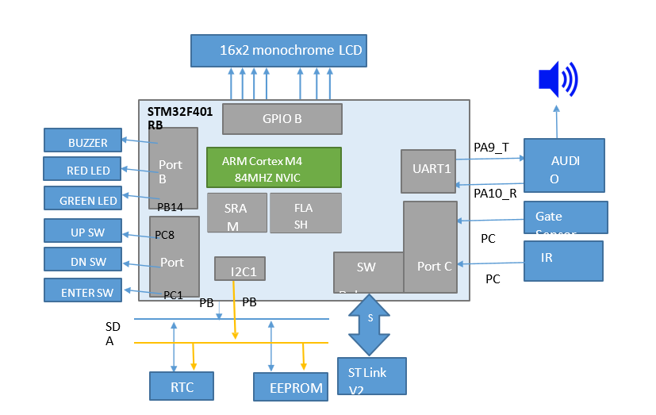
Main Requirements
1
Gate Status Detection
2
Audio Announcements
Use a Reed sensor to detect if the gate is open or closed. Use an IR beam sensor to determine if the gate was opened from inside or outside.
Play different audio tracks based on the gate status and time of day. For example, play a greeting message when the gate is opened from outside, and a thank-you message when the gate is closed.
3
Periodic Gate Check
After detecting that the gate is open, periodically check if it has been closed. If the gate remains open, play an audio reminder to close it.

Slide 18
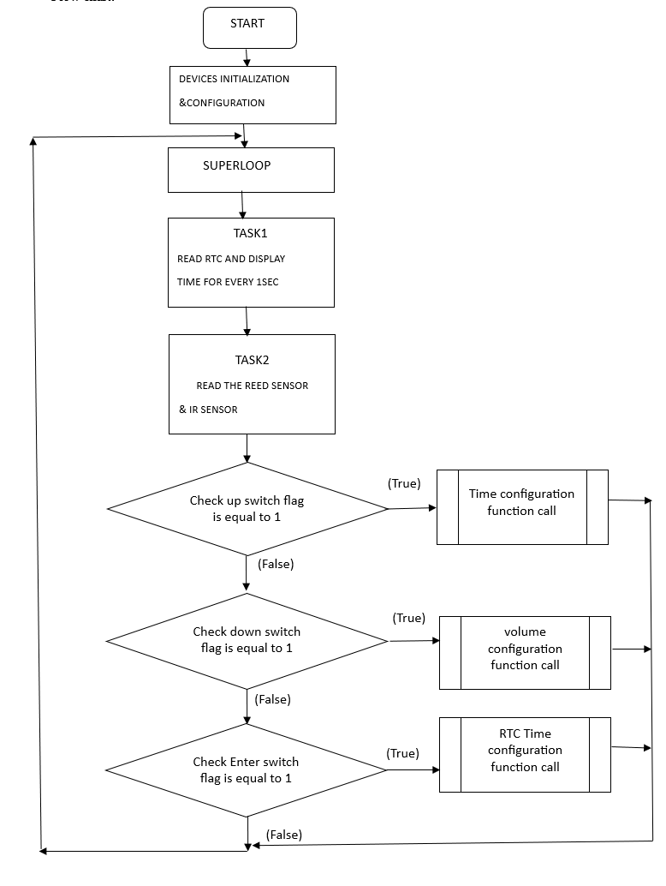
Additional Requirements
Power-Up Display
Time and Date Display
On power-up, the GMS should display "GATE MONITORING V1.0" on the LCD.
When the gate is closed and no audio tracks are playing, display the current time and date on the LCD.
Gate Announcement Display
When the gate is opened, display "Gate Announce..." on the LCD, along with an appropriate greeting message or "Thank You" based on the opening direction.

Slide 19
Configuration Requirements
Date and Time Configuration
Volume Change
Allow the user to configure the date and time using the ENTER, UP, and DOWN switches. The configuration mode should be accessible during power-up.
Allow the user to adjust the volume of the audio module using the UP and DOWN switches during normal operation. The volume setting should be displayed on the LCD.

Slide 20





Software Architecture - High Level
1
Tasks
2
Sensor Status
3
Display Date/Time
4
Gate Announcements
5
Volume Change
The GMS will manage the four tasks: Sensor Status, Display Date/Time, Gate Announcements, and Volume Change. These tasks will interact with each other using flags to ensure proper synchronization and protection.

Slide 21
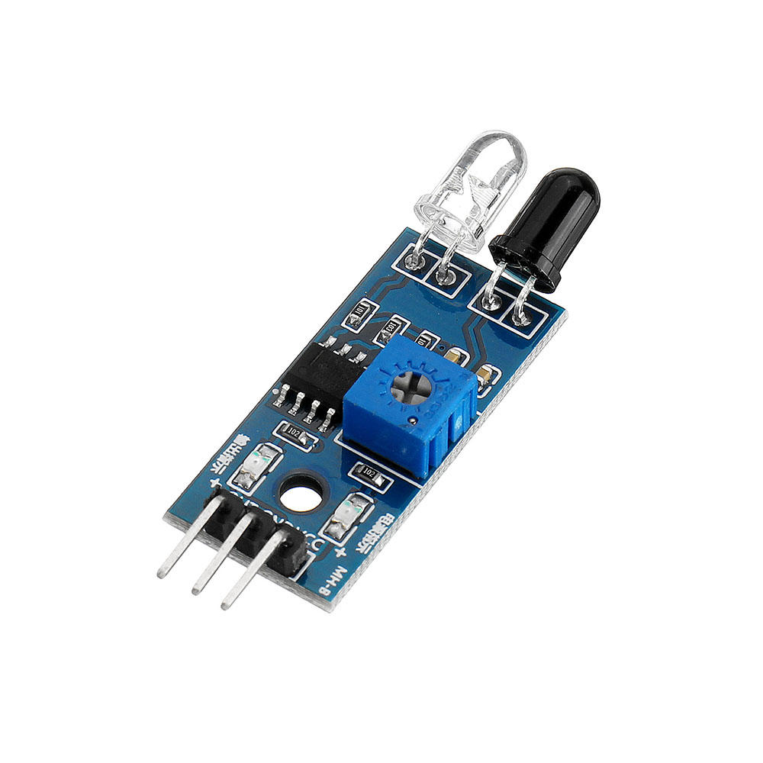


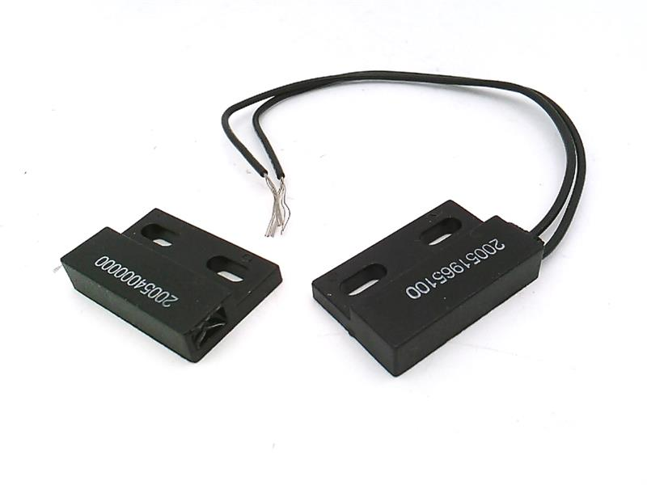
Task 1: Sensor Status
Gate Sensor
IR Sensor
Wait for the gate sensor to signal that the gate is open. Set the Gate_Sensor_Flag when the sensor is activated.
Wait for the IR sensor to signal that the gate has been opened. Set the IR_Sensor_Flag when the sensor is activated.

Slide 22

Task 2: Display Date/Time
Every second, read the date and time from the DS1307 RTC and display it on the LCD. This task will run continuously in the background.

Slide 23
Task 3: Gate Announcements
Gate Open
1
When the Gate_Sensor_Flag is set, check the IR_Sensor_Flag after a 50 msec delay.
2
IR Sensor Active
If the IR_Sensor_Flag is set, play audio track 4 and display the appropriate message on the LCD.
IR Sensor Inactive
3
If the IR_Sensor_Flag is not set, play the appropriate greeting message (track 5/6/7/8) followed by track 1 and display the appropriate message on the LCD.
4
Gate Open Loop
Play audio track 2 every 3 seconds until the Gate_Sensor_Flag is cleared.
Gate Closed
5
Play audio track 3 and return to waiting for the sensors to change state.

Slide 24
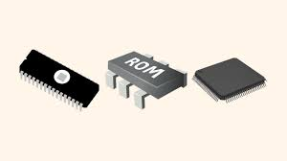
Task 5:EEPROM and I2C Protocol
What is EEPROM?
EEPROM stands for Electrically Erasable Programmable Read-Only Memory.
A non-volatile memory that retains data even when power is lost.
Typically used for storing small amounts of data, such as configuration settings or user preferences.
I2C Communication Overview:
Two-Wire Bus:
SDA (Serial Data Line) – for data transfer.
SCL (Serial Clock Line) – for synchronization of data transfer.
Master-Slave Architecture: The master (e.g., microcontroller) initiates communication, and the EEPROM acts as the slave.

Slide 25
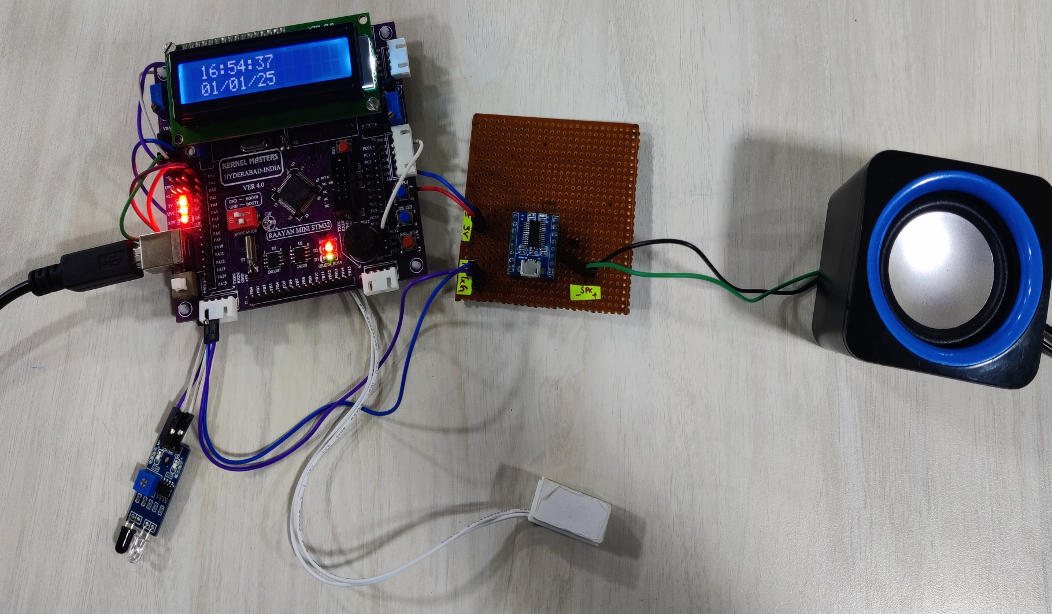
HARDWARE KIT SHOWING RESULT OF TIME AND DATE

Slide 26
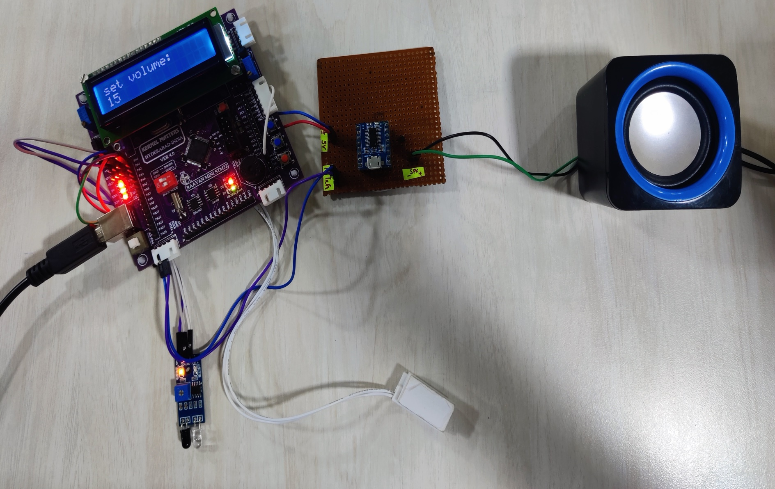
HARDWARE KIT SHOWING RESULT OF VOLUME SET

Slide 27
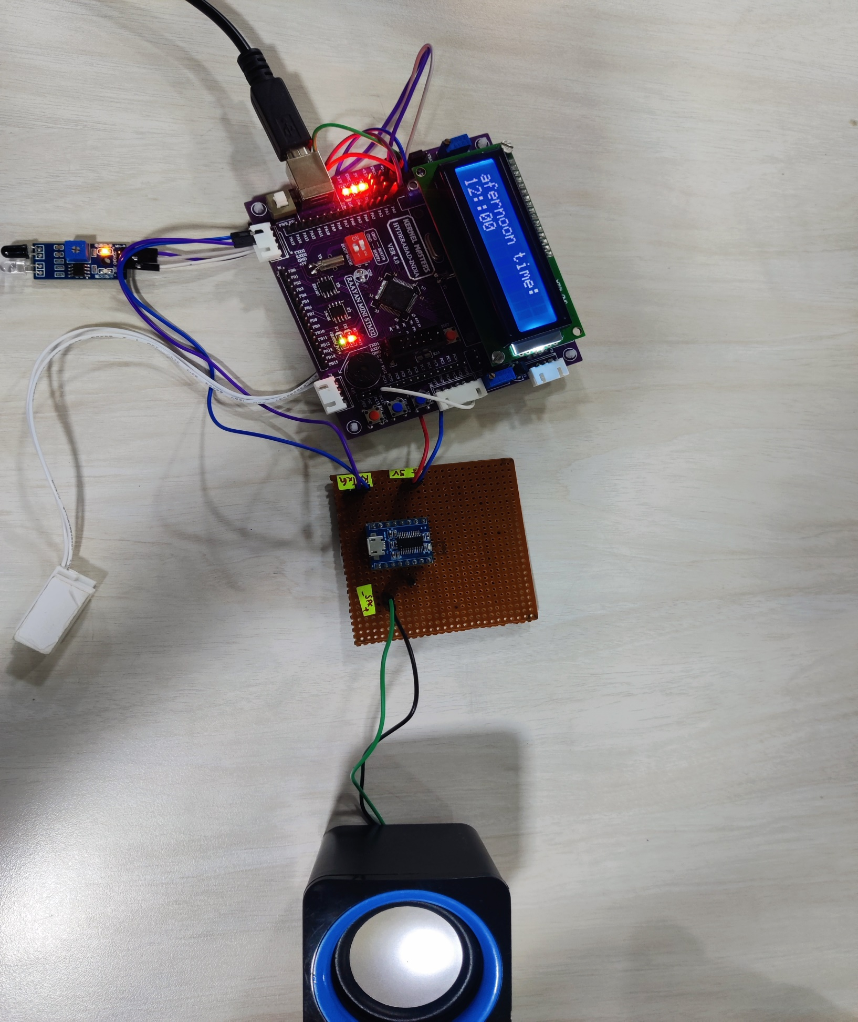
HARDWARE KIT SHOWING RESULT OF GREETING

Slide 28
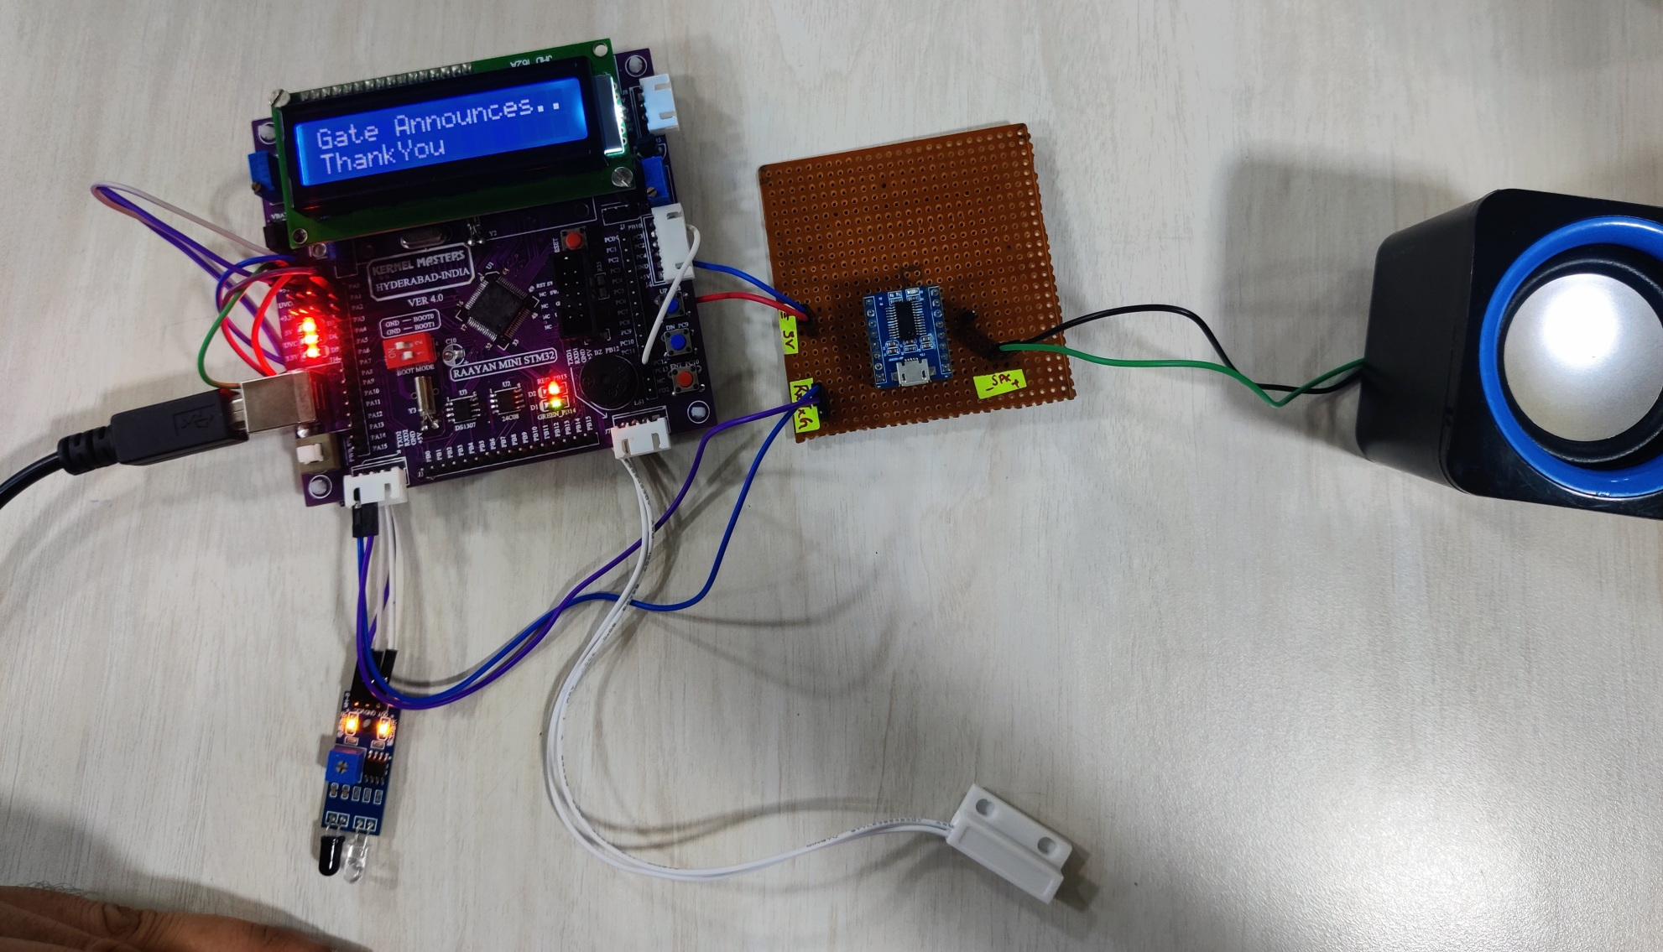
HARDWARE KIT SHOWING RESULT OF GATE ANNOUNCE

Slide 29
Your best quote that reflects your approach… “It’s one small step for man, one giant leap for mankind.”
- Neil Armstrong

